Slide 1
Mining Association Rules ——Efficient and scalable frequent itemset mining methods——
徐华
清华大学 计算机系 智能技术与系统国家重点实验室
xuhua@tsinghua.edu.cn

Slide 2
Association and Correlations
Association and Correlations
Efficient and Scalable Frequent Itemset Mining Methods
Mining Various Kinds of Association Rules
From Association Mining to Correlation Analysis
Constraint-based Association Mining

Slide 3
Scalable Methods for Mining Frequent Patterns
The downward closure (向下闭) property of frequent patterns
Any subset of a frequent itemset must be frequent
If {beer, diaper, nuts} is frequent, so is {beer, diaper}
i.e., every transaction having {beer, diaper, nuts} also contains {beer, diaper}
Scalable mining methods: Three major approaches
Apriori (Agrawal & Srikant@VLDB’94)
Freq. pattern growth (FPgrowth—Han, Pei & Yin @SIGMOD’00)
Vertical data format approach (Charm—Zaki & Hsiao @SDM’02)

Slide 4
Apriori: A Candidate Generation-and-Test Approach
Apriori pruning principle: If there is any itemset which is infrequent, its superset should not be generated/tested! (Agrawal & Srikant @VLDB’94, Mannila, et al. @ KDD’ 94)
Method:
Initially, scan DB once to get frequent 1-itemset
Generate length (k+1) candidate itemsets from length k frequent itemsets
Test the candidates against DB
Terminate when no frequent or candidate set can be generated

Slide 5
The Apriori Algorithm—An Example
Sup_{min} = 2
Itemset | sup
{A} | 2
{B} | 3
{C} | 3
{D} | 1
{E} | 3
Database TDB
Itemset | sup
{A} | 2
{B} | 3
{C} | 3
{E} | 3
L₁
Tid | Items
10 | A, C, D
20 | B, C, E
30 | A, B, C, E
40 | B, E
C₁
1st scan
C₂
Itemset | sup
{A, B} | 1
{A, C} | 2
{A, E} | 1
{B, C} | 2
{B, E} | 3
{C, E} | 2
C₂
Itemset
{A, B}
{A, C}
{A, E}
{B, C}
{B, E}
{C, E}
L₂
Itemset | sup
{A, C} | 2
{B, C} | 2
{B, E} | 3
{C, E} | 2
2nd scan
How？
why
C₃
Itemset
{B, C, E}
3rd scan
L₃
Itemset | sup
{B, C, E} | 2

Slide 6
The Apriori Algorithm
Pseudo-code:
C_{k}: Candidate itemset of size k
L_{k} : Frequent itemset of size k
L₁ = {frequent items};
for (k = 1; L_{k} !=∅; k++) do begin
C_{k+1} = candidates generated from L_{k};
for each transaction t in database do
increment the count of all candidates in C_{k+1}
that are contained in t
L_{k+1} = candidates in C_{k+1} with min_support
end
return ∪_{k} L_{k};

Slide 7
Important Details of Apriori
How to generate candidates?
Step 1: self-joining L_{k}
Step 2: pruning
How to count supports of candidates?
Example of Candidate-generation
L₃={abc, abd, acd, ace, bcd }
Self-joining: L₃*L₃
abcd from abc and abd
acde from acd and ace
Pruning:
acde is removed because ade is not in L₃
C₄={abcd }

Slide 8
How to Generate Candidates?
Suppose the items in L_{k-1} are listed in an order
Step 1: self-joining L_{k-1}
insert into C_{k}
select p.item₁, p.item₂, …, p.item_{k-1}, q.item_{k-1}
from L_{k-1} p, L_{k-1} q
where p.item₁=q.item₁, …, p.item_{k-2}=q.item_{k-2}, p.item_{k-1} < q.item_{k-1}
Step 2: pruning
For all itemsets c in C_{k} do
For all (k-1)-subsets s of c do
if (s is not in L_{k-1}) then delete c from C_{k}

Slide 9
Challenges of Frequent Pattern Mining
Challenges
Multiple scans of transaction database
Huge number of candidates
Tedious workload of support counting for candidates
Improving Apriori: general ideas
Reduce passes of transaction database scans
Shrink number of candidates
Facilitate support counting of candidates

Slide 10
Bottleneck of Frequent-pattern Mining
Multiple database scans are costly
Mining long patterns needs many passes of scanning and generates lots of candidates
To find frequent itemset i₁i₂…i₁₀₀
# of scans: 100
# of Candidates: (₁₀₀¹) + (₁₀₀²) + … + (₁¹₀⁰₀⁰) = 2¹⁰⁰-1 = 1.27*10³⁰ !
Bottleneck: candidate-generation-and-test
Can we avoid candidate generation?

Slide 11
Mining Frequent Patterns Without Candidate Generation
Grow long patterns from short ones using local frequent items
“abc” is a frequent pattern
Get all transactions having “abc”: DB|abc
“d” is a local frequent item in DB|abc → abcd is a frequent pattern

Slide 12
Construct FP-tree from a Transaction Database
TID Items bought (ordered) frequent items
100 {f, a, c, d, g, i, m, p} {f, c, a, m, p}
200 {a, b, c, f, l, m, o} {f, c, a, b, m}
300 {b, f, h, j, o, w} {f, b}
400 {b, c, k, s, p} {c, b, p}
500 {a, f, c, e, l, p, m, n} {f, c, a, m, p}
min_support = 3
{}
Scan DB once, find frequent 1-itemset (single item pattern)
Sort frequent items in frequency descending order, f-list
Scan DB again, construct FP-tree
Header Table
Item frequency head
f 4
c 4
a 3
b 3
m 3
p 3
f:4
c:1
c:3
b:1
b:1
a:3
p:1
m:2
b:1
F-list=f-c-a-b-m-p
p:2
m:1

Slide 13
Benefits of the FP-tree Structure
Completeness（完备性）
Preserve complete information for frequent pattern mining
Never break a long pattern of any transaction
Compactness（紧致性）
Reduce irrelevant info—infrequent items are gone
Items in frequency descending order: the more frequently occurring, the more likely to be shared
Never be larger than the original database (not count node-links and the count field)

Slide 14
Partition Patterns and Databases
Frequent patterns can be partitioned into subsets according to f-list
F-list=f-c-a-b-m-p
Patterns containing p
Patterns having m but no p
…
Patterns having c but no a nor b, m, p
Pattern f
Completeness and non-redundency

Slide 15
Find Patterns Having P From P-conditional Database
Starting at the frequent item header table in the FP-tree
Traverse the FP-tree by following the link of each frequent item p
Accumulate all of transformed prefix paths of item p to form p’s conditional pattern base
{}
Header Table
Item frequency head
f 4
c 4
a 3
b 3
m 3
p 3
Conditional pattern bases
item cond. pattern base
c f:3
a fc:3
b fca:1, f:1, c:1
m fca:2, fcab:1
p fcam:2, cb:1
f:4
c:1
c:3
b:1
b:1
a:3
p:1
m:2
b:1
p:2
m:1

Slide 16
From Conditional Pattern-bases to Conditional FP-trees
For each pattern-base
Accumulate the count for each item in the base
Construct the FP-tree for the frequent items of the pattern base
m-conditional pattern base:
fca:2, fcab:1
{}
Header Table
Item frequency head
f 4
c 4
a 3
b 3
m 3
p 3
f:4
c:1
All frequent patterns relate to m
m,
fm, cm, am,
fcm, fam, cam,
fcam
{}
c:3
b:1
b:1

f:3

a:3
p:1
m:2
b:1
c:3
p:2
m:1
a:3
m-conditional FP-tree

Slide 17
Recursion: Mining Each Conditional FP-tree
{}
{}
Cond. pattern base of “am”: (fc:3)
f:3
c:3
f:3
am-conditional FP-tree
c:3
Cond. pattern base of “m”: (f:3)
a:3
m-conditional FP-tree
{}
Cond. pattern base of “cam”: (f:3)
f:3
cam-conditional FP-tree

Slide 18
A Special Case: Single Prefix Path in FP-tree
Suppose a (conditional) FP-tree T has a shared single prefix-path P
Mining can be decomposed into two parts
Reduction of the single prefix path into one node
Concatenation of the mining results of the two parts
{}
a₁:n₁
a₂:n₂
a₃:n₃
{}
r₁
a₁:n₁
+
C₁:k₁

r₁
=
C₁:k₁
b₁:m₁
b₁:m₁
a₂:n₂
C₂:k₂
C₃:k₃
a₃:n₃
C₂:k₂
C₃:k₃

Slide 19
Mining Frequent Patterns With FP-trees
Idea: Frequent pattern growth
Recursively grow frequent patterns by pattern and database partition
Method
For each frequent item, construct its conditional pattern-base, and then its conditional FP-tree
Repeat the process on each newly created conditional FP-tree
Until the resulting FP-tree is empty, or it contains only one path—single path will generate all the combinations of its sub-paths, each of which is a frequent pattern

Slide 20
FP-growth Algorithm
FP tree construct procedure:
Scan the transaction database D once, construct the F-list
Scan the transaction database D again,
Construct the FP_tree using Insert_tree()
procedure FP_growth(Tree, )
(1) if Tree contains a single path P then
(2) for each combination ( ) of the nodes in the path P
(3) generate pattern with support count = minimum support count of nodes in ;
(4) else for each a_{i} in the header of Tree {
(5) generate pattern = a_{i} with support count = a_{i}.support;
(6) construct 's conditional pattern base and then 's conditional FP tree Tree ;}
(7) if ; then
(8) call FP_growth( ; );
∪
∪

Slide 21
FP-Growth vs. Apriori: Scalability With the Support Threshold

Slide 22
Why Is FP-Growth the Winner?
Divide-and-conquer:
decompose both the mining task and DB according to the frequent patterns obtained so far
leads to focused search of smaller databases
Other factors
no candidate generation, no candidate test
compressed database: FP-tree structure
no repeated scan of entire database
basic ops—counting local freq items and building sub FP-tree, no pattern search and matching

Slide 23
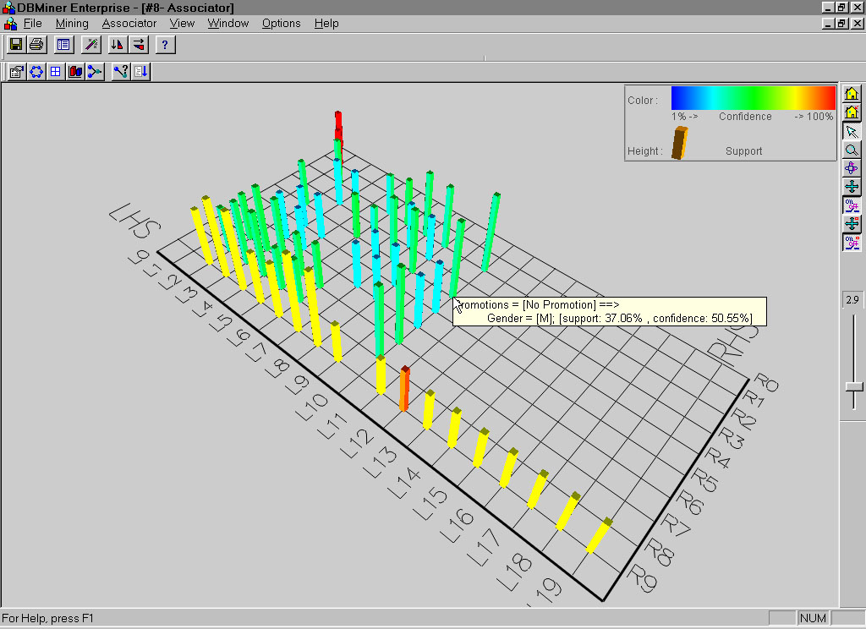
Visualization of Association Rules: Plane Graph

Slide 24
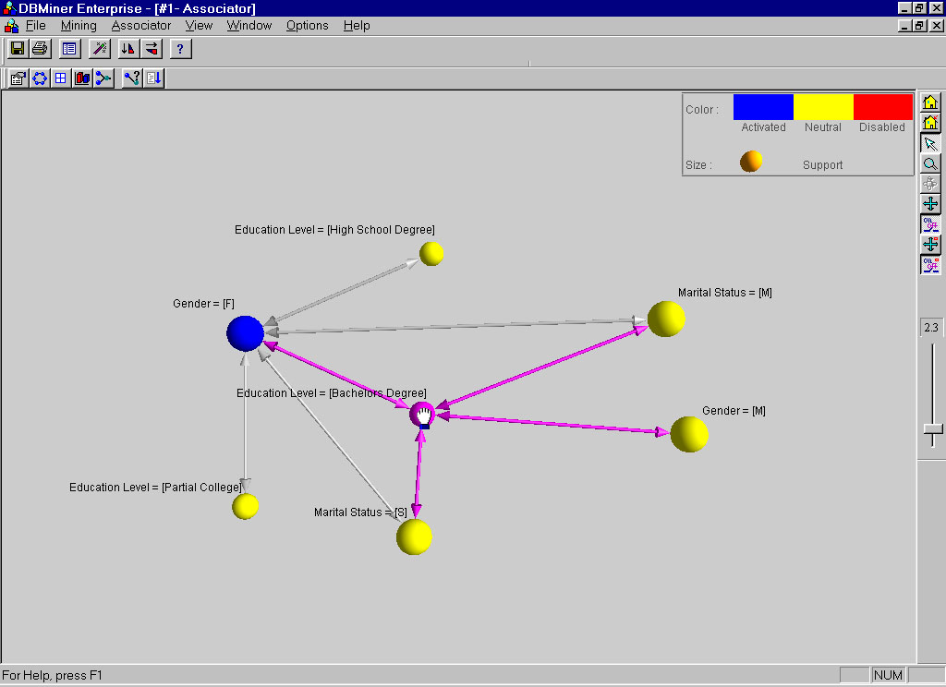
Visualization of Association Rules: Rule Graph

Slide 25
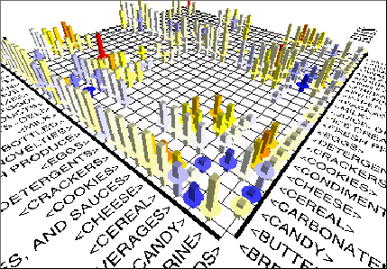
Visualization of Association Rules (SGI/MineSet 3.0)

Slide 26
Thanks！

